Slide 1

Enumerating hosts using wireshark, windows and linux commands.
Samuel depriest
09/12/2024

Slide 2
Objective
learn to enumerate or list various resources on a target host.
Tools:
Nmap
Kali
Wireshark
Postgresql

Slide 3
Introduction

Slide 4
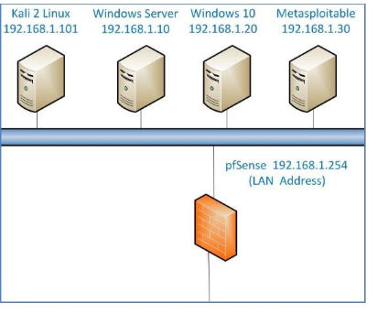
Topology

Slide 5
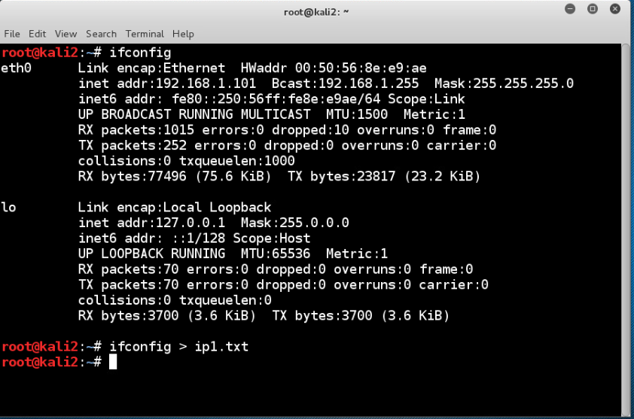
Using Ifconfig to get IP info the saving ti to a txt file

Slide 6
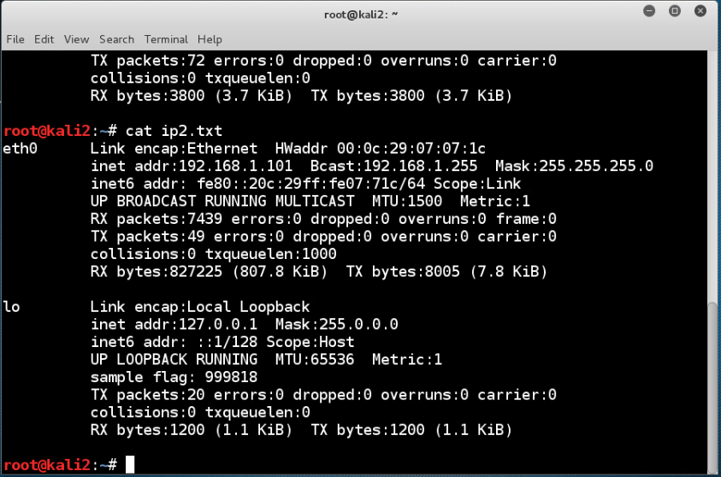
Using cat to view the txt file for flag

Slide 7
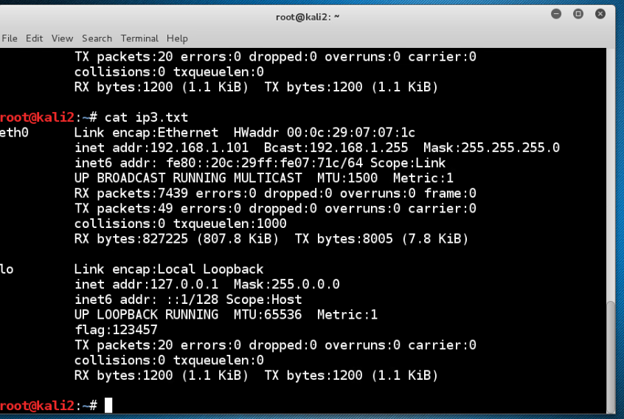
Using cat to view another file to obtain the flag

Slide 8
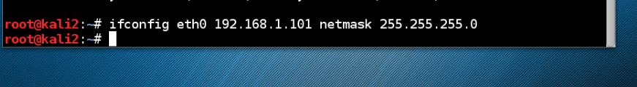
Setting IP and subnet mask

Slide 9

Setting gateway

Slide 10

Backing up current config file of ip

Slide 11
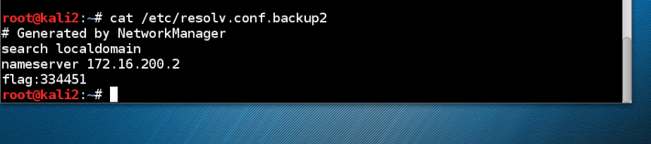
Viewing backup file for .backup2 for flag

Slide 12

Setting the DNs Server

Slide 13
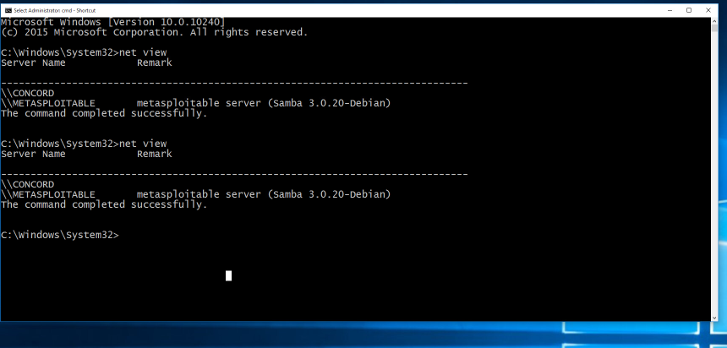
Enumerate machines with windows

Slide 14
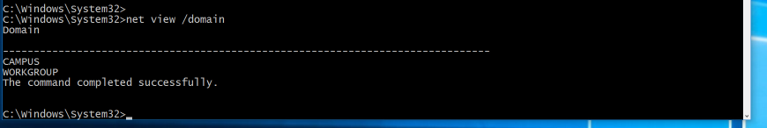
Enumerate domains with windows

Slide 15
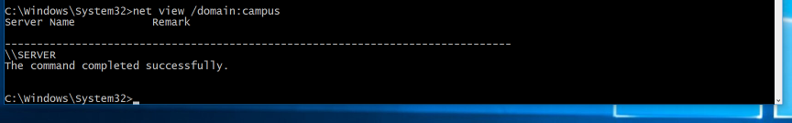
Enumerate on campus domain

Slide 16
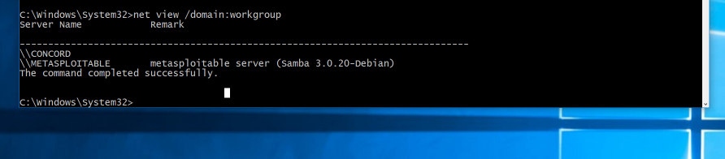
Enumerate on workgroup domain

Slide 17
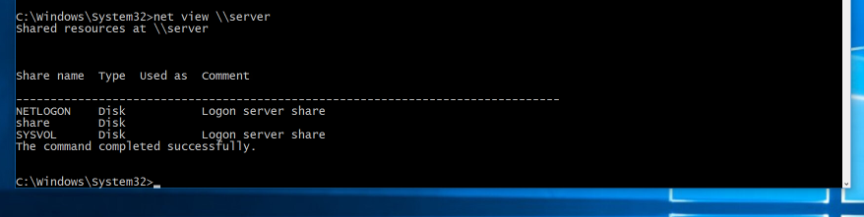
Enumerate shares on machine server

Slide 18
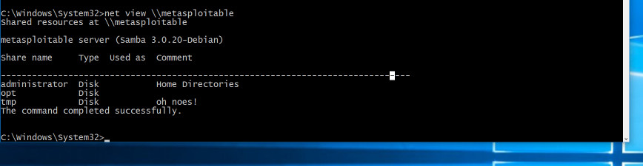
Enumerate on machine metasploitable

Slide 19
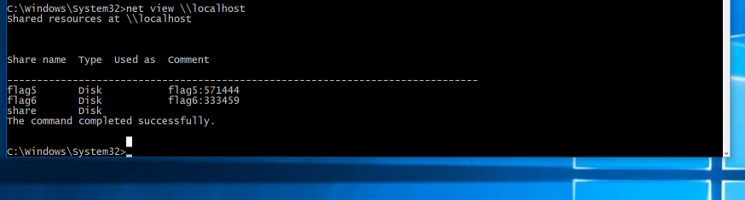
Enumerate on local machine for flag

Slide 20
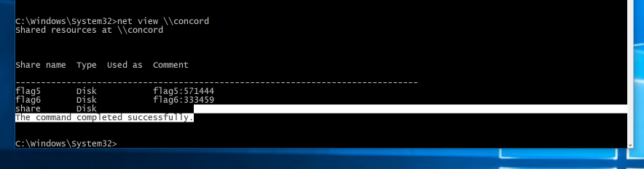
Enumerate on concord machine for flag

Slide 21
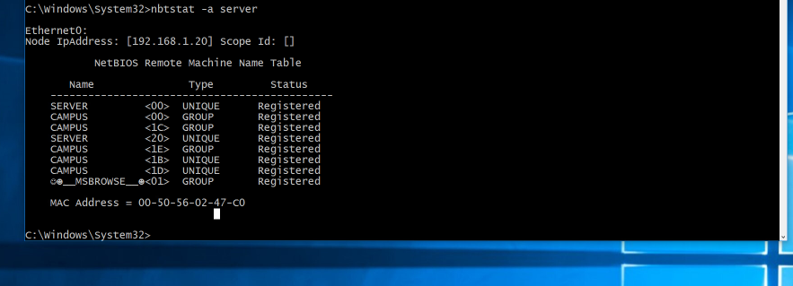
Enumerate ip and mac address of server machine

Slide 22
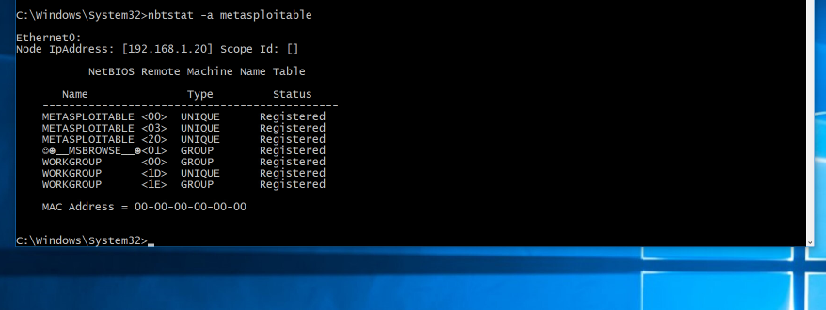
Enumerate ip and mac address of metasploitable machine

Slide 23
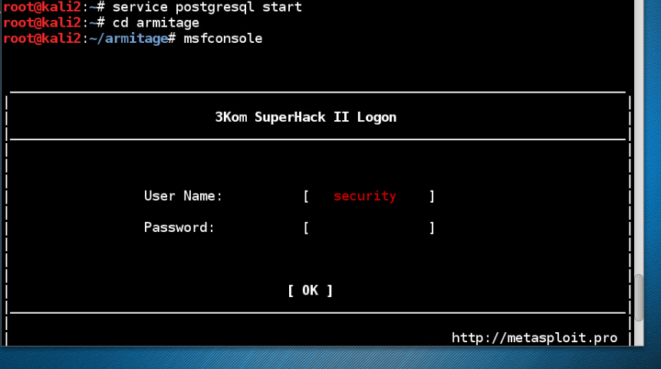
Starting postgresql the Armitage then swapping to metasploitdb_nmap –T4 –A –v 192.168.1.*

Slide 24
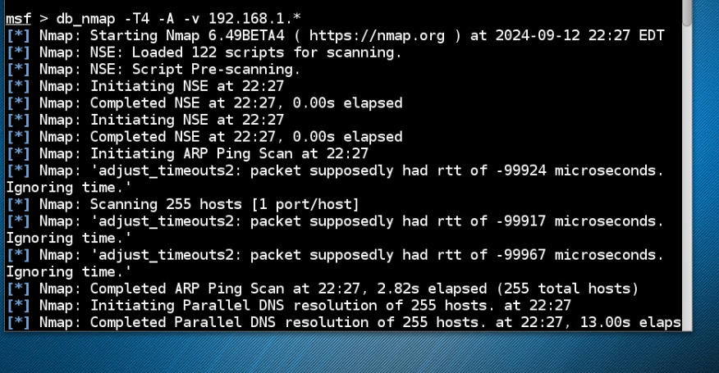
Using nmap command in msf db_nmap –T4 –A –v for an agrgressive scan produces a file in xml format that is fast on the scan with heavy details

Slide 25
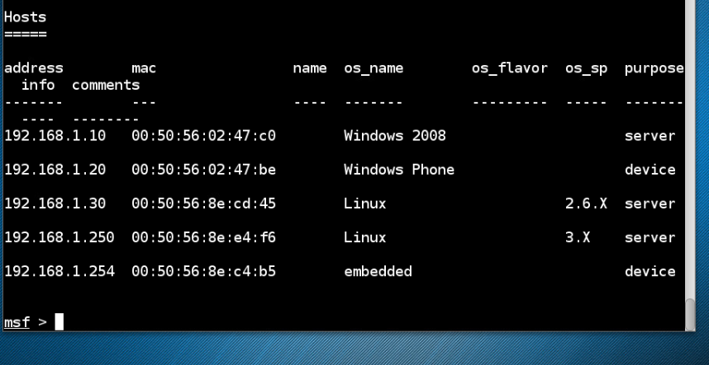
Viewing hosts from the nmap scan above

Slide 26
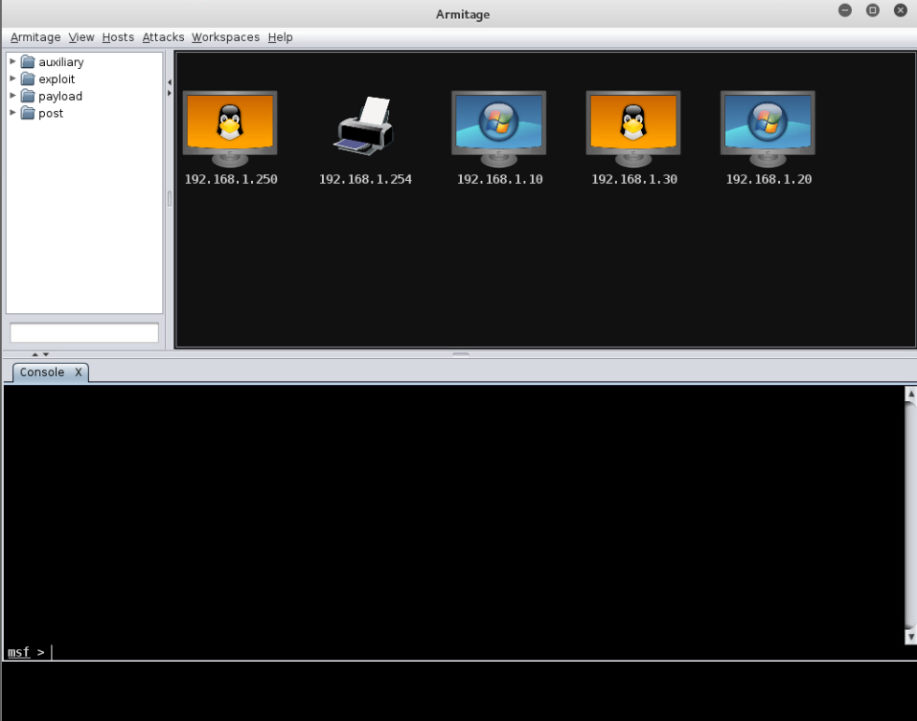
Armitage view of machines to exploit

Slide 27
Conclusion
We utilized different tools to obtain the objective which was enumeration on machines and domains to obtain the flags needed. We also utilized Armitage to view the machines we could exploit if needed.

